Slide 1
Virus Outbreak
Parallel Games

Slide 2
Genre
Survival
Shooter
Multi-directional shooter

Slide 3
System Requirements
PC
OS: Windows 7 SP1+, macOS 10.11+, Ubuntu 12.04+, SteamOS+
Graphics card with DX10 (shader model 4.0) capabilities
CPU: SSE2 instruction set support

Slide 4
Game Play/Mechanics
2D
Real Time
Top-down
Mouse/Keyboard combo input

Slide 5
Game Story
You are playing as an antibiotic by the name Peni (Penicillin), who is eradicating foreign invaders such as bacteria and viruses in the human body. See how long you can survive without getting infected.

Slide 6
Game Controls & User Interface
W – forward movement
S – backward movement
A – leftward movement
D – Rightward movement
Mouse (Movement) – Aim
Mouse (Left Click) - Shoot
H.U.D – Includes players:
HP – Health Points
EXP – Experience Bar
LVL – Player’s Current Level
Score – Player’s Current Score
Weapon Type/Inventory

Slide 7
Replay-ability
Our game will have a level system, different scenes, high score ranking system, and take place inside the human body (large opportunity for new levels/ideas). Related virus can range from the common cold to the most dangerous of infections and diseases, such as cancer.

Slide 8

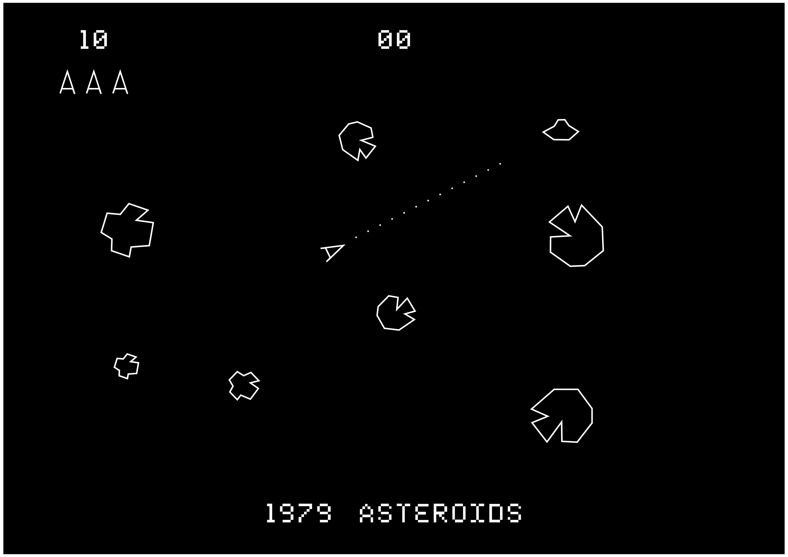
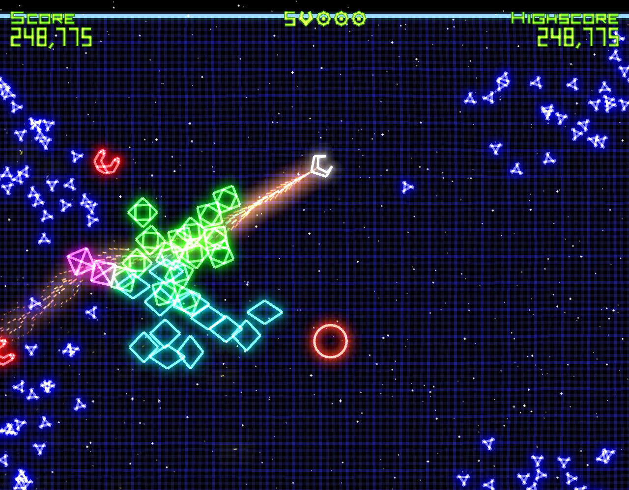
Inspiration & Examples
Asteriods (1979)
Geometry Wars

